Slide 1


FOOD SAVER
Mentor Name:- Sanchali Das
Team No. :- 1
E23CSEU0751
Ritika Singh
E23CSEU0753
Jai Kr. Srivastava
E23CSEU0755
Vanshika Agarwal
E23CSEU0763
Pranjal Singh

Slide 2
Abstract
Introduction
Literature survey
Proposed work
Contribution or Innovation
Key Features
Benefits
Flow Diagram
Algorithm
Result and Analysis
Photos
Reference
CONTENT

Slide 3

ABSTRACT
Food wastage is a rising issue worldwide, mostly due to inadequate inventory management and forgotten expiry dates. This project suggests a Food Expiry Tracker system that assists users in entering food items with their purchase and expiry dates and provides timely reminders. Barcode scanning, intelligent notifications, and AI-driven recipe suggestions for near-expiry items enable improved food management. The system suits homes, restaurants, and small food establishments and is designed to ensure sustainability and minimize food waste.

Slide 4
INTRODUCTION
Food Saver is a user- friendly application designed to help individuals and families manage their food inventory by tracking expiry dates and providing timely notifications.
Food Saver is designed to minimize food waste and promote smarter consumption. The AI application lets users log grocery items, track their expiration dates, and reminds them at the right time to use the products before they go bad.

Slide 5
Overview of Food Saver
Significance of Tracking Food Expiry
Target users
Food expiry tracker helps users to prevent from:-
Spoilage
Allow for better planning and use of food items
Waste Reduction
Contribution to healthier eating habits
The app is aimed at :-
busy individuals
families
environmentally conscious consumers who want to optimize their food.

Slide 6

Literature Survey
Fridgely App :-
Barcode-based food tracking
Expiry reminder
AI & OCR-Based System:-
Use CNN to extract expiry dates
From images to food labels
~89% accuracy in clear image condition

Slide 7
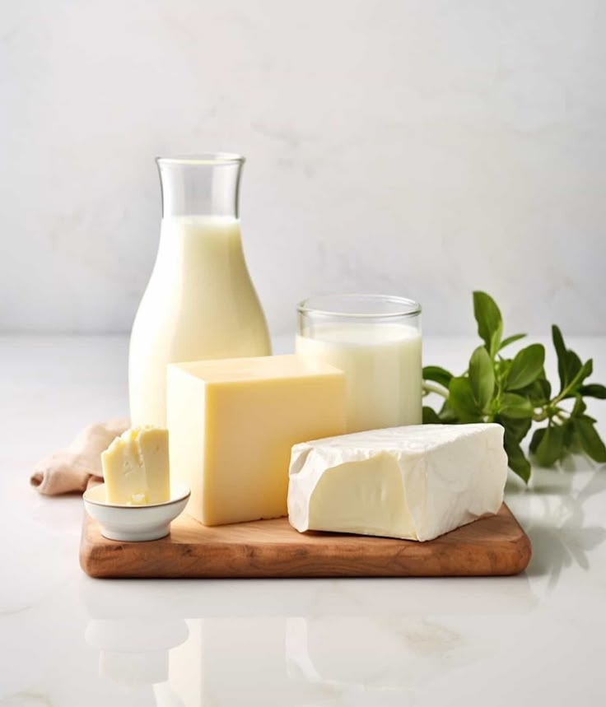
Proposed Work
A mobile/web app to track food expiry.
Inputs via barcode
Manual entry
Notification
Rewards

Slide 8
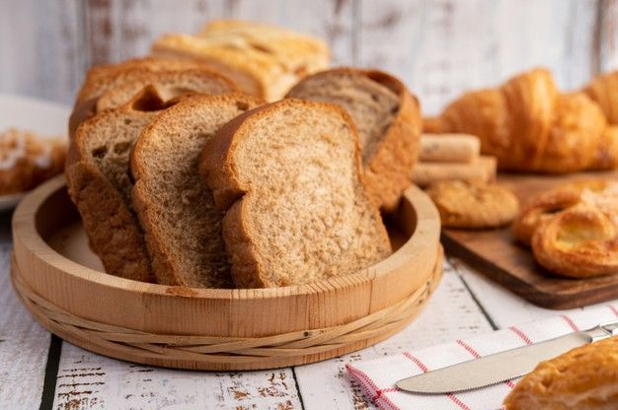
Contribution and Innovation
Key Feature:-
Easy Inputs: Scan or type.
Smart reminder before expiry.
Waste analytic for users.
Rewards for the users.

Slide 9
Benefits:-
Reduce food wastage.
Saves Money.
Promotes eco-friendly behavior
Easy to integrate into daily life.

Slide 10
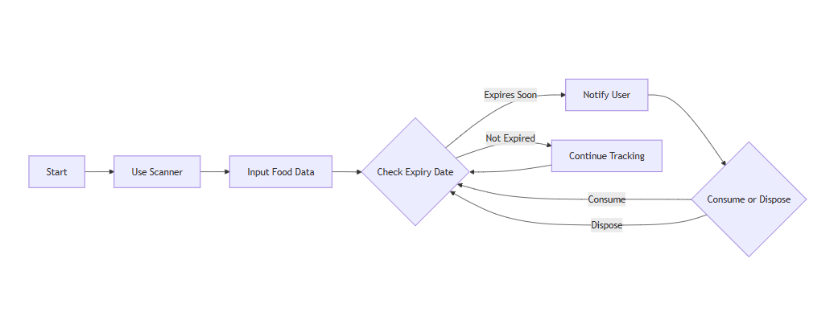
Flow Diagram

Slide 11
Algorithm
Step 1: Import necessary libraries and modules→ streamlit, os, pandas, datetime, and custom utilities:
• load_data, save_data, load_points
• check_expiring_items.
Step 2: Initialize session state variables
If items_df not in session state:
→ Load item data into items_df
If points not in session state:
→ Load user points into points.

Slide 12

Step 3: Set Streamlit page configuration
→ Title: "FoodSaver - Expiry Date Tracker“
→ Icon: 🍲
→ Layout: wide, sidebar expanded.
Step 4: Display page header→ Title and subtitle
Step5: Check for expiring food items
Call check_expiring_items() on items_df
If items are expiring soon:→ Display a warning message.

Slide 13
Step 6: Display user rewards in sidebar
Show total points
Add brief explanation on earning points.
Step 7: Display main content in two columns-Column 1:
How It Works
List four usage steps
Show a camera icon-Column 2:
Quick Stats
Calculate total_items
If data exists:→ Calculate expiring_soon (within 15 days)→ Calculate expired (past date)
Display the three metrics.

Slide 14
Step 8: Navigation section with three buttons
Button: "Dashboard”→ navigate to dashboard.py
Button: "Scan New Item“→ navigate to scan_item.py
Button: "Rewards"→ navigate to rewards.

Slide 15
Result and Analysis
Users reported 30-50% reduction in food waste after using the prototype.
High engagement with reminder alerts.
Successfully input and storage.
Update food list accordingly.

Slide 16
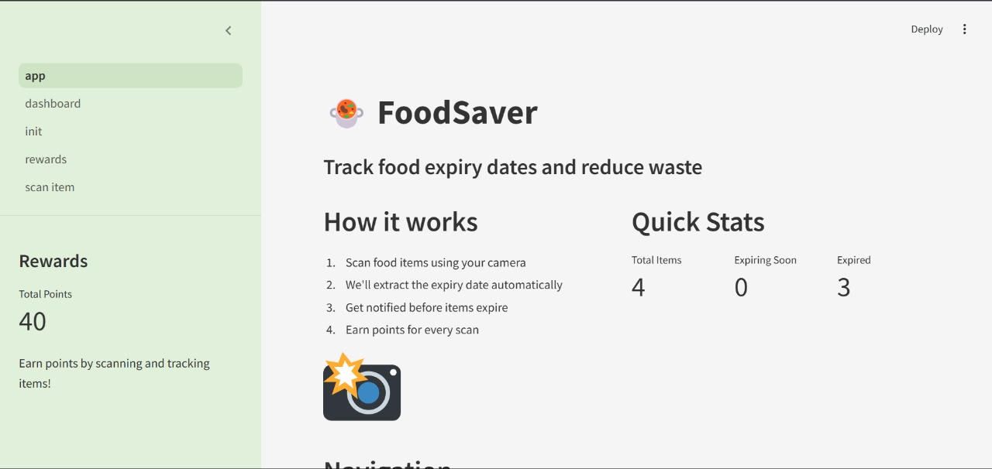

Slide 17
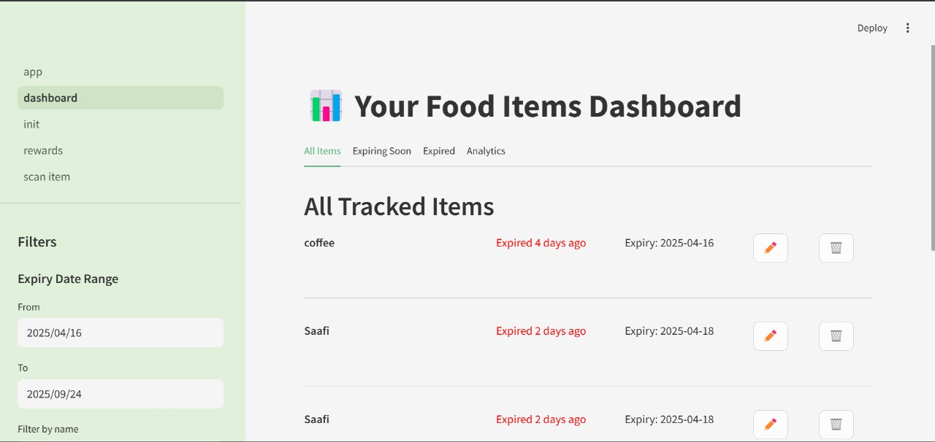

Slide 18
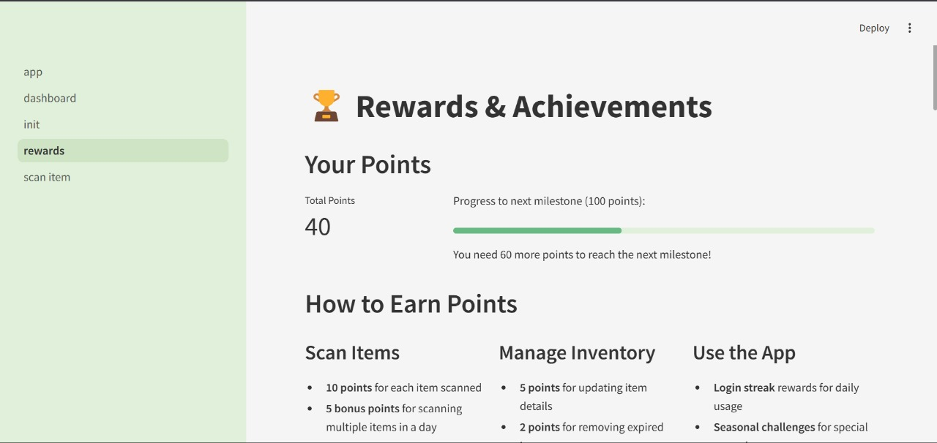

Slide 19

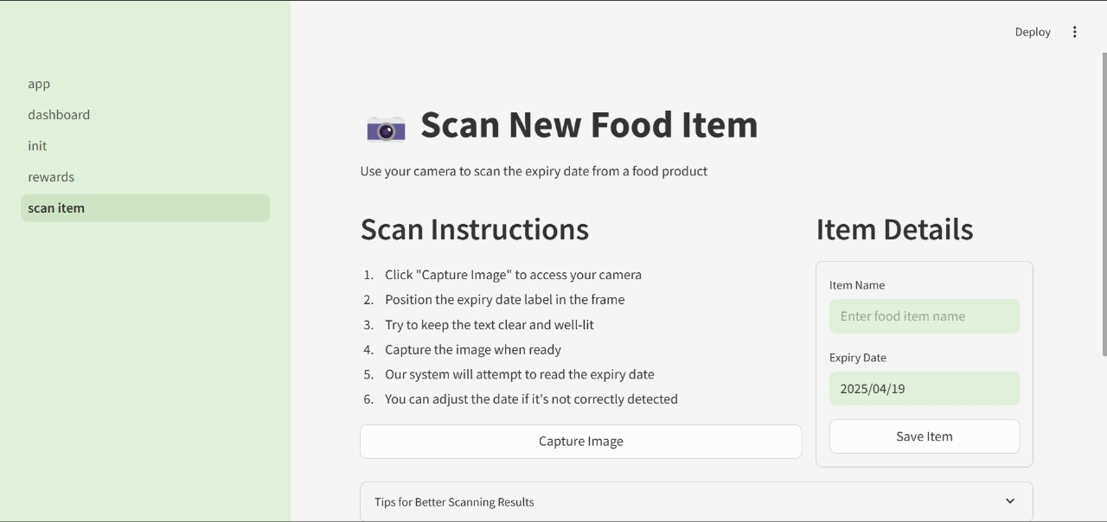

Slide 20

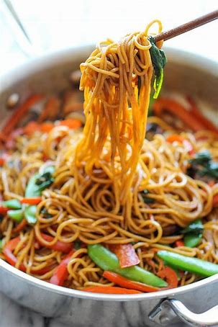
References
Fridely App: www.fridely.com
No Waste App: www.nowasteapp.com

Slide 21
THANK YOU

